Slide 1
Cork | Sec #2 (also DC021353)
18:30-19:30 Socialising ☺
19:30-19:50 "Personal email accounts - the holy grail of identity theft" - Marcus Viertel
19:55-20:15 – “A little .bit odd - fun with Alternative Domain Roots" by Bob McArdle
20:15-??? More Socialising
SSID: FreeWifiAskServerVIP = sohowifi
corksec.robertmcardle.com
Notes:
Hi Everyone and thanks for coming to the second version of Cork|Sec, which is exactly one more that I expected to get to ☺
For those that where not here before – let me give you an overview
I put this group together because we have quite a few Security companies around Cork at the moment, and even more people who are interested in the whole area of security. I wanted a place where we can get together once a month to socialise, and learn something practical and interesting at the same time. Even though the group name is Cork|Sec I’m also expecting techie projects as well as security ones to be presented over the coming months.
This group is modelled on a Defcon group (and in fact I may change the group name eventually if it takes off and Defcon ever come back to me). That means that it is open to Hackers and Security Folks alike. All backgrounds, ages and skill levels are welcome
The agenda for tonight is a simple. This time around instead of one 45 minute talk, we have two 20 minutes ones. Talks will kick off at 19:30 and we’’ll have socialising either side of that. First up tonight is Marcus Viertel talking about Personal Email Account hacks, and then I’ll talk about Alternative Domain Roots (and .BIT in particular).
I’m really hoping that next month I WON’T be presenting next month. This whole series will work a lot better if people volunteer to speak on topics they are interested in. If you have any topics, for any amount of time – just let me know. I’m also looking for someone to do a 5 minute lightning talk on a topic they are only starting to research, but are looking for others who are interested too.
There are lots of things you can talk about – so don’t be afraid. You could just as easily talk about some security tool / how to secure a network / building your own quadcopter / social engineering / some malware – whatever you like as long as its both interesting and practical
INTRO MYSELF

Slide 2
A little .bit odd Fun with Alternative Domain Roots
Bob McArdle
@BobMcArdle
Cork | Sec
Notes:
For this talk I will give an overview of a curious case I came across featuring the .BIT TLD, and some of the work myself and my team have done on researching this area.
Incidentally I was trying to decide whether to call this talk “Son of a .bit” but this title won out

Slide 3
http://bitshara.bit/admin/host.php
Notes:
The whole idea for this research started with a particularly strange malware sample I was investigating. The malware was connecting to a domain called bitshara.bit – and we were wondering if this was a targeted attack. After a bit more investigation it turned out this wasn’t targeted – but it was still odd
What was interesting for me of course was the .BIT TLD part – I had never heard of it before personally. Some trusty googling later and I had a better understanding of this particular TLD.
.BIT belongs to an “Alternative DNS Root”. An Alternative DNS Root is essentially any TLD that is not officially in the list of TLD administered by ICANN. Before I go into details on .BIT in particular, lets look at some of the other Alternative TLDs.

Slide 4

Notes:
When the internet was first founded a non-profit organisation called the Internet Corporation for Assigned Names and Numbers (ICANN) was put together. Their purpose is to oversea a number of Internet related tasks. For starters they are responsible for the coordination of the DNS Root Zone of the Internet, and for the allocation of all IPv4 and IPv6 addresses. The IP allocation is handled by a sub organisation called IANA

Slide 5

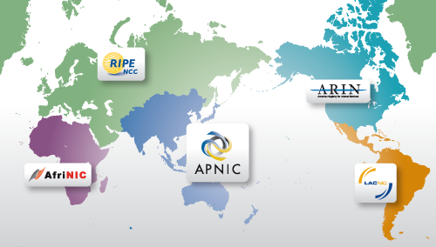
Notes:
All of the Internets 4294967296 IP addresses are assigned by the Internet Assigned Number Authority. It split the IP address space up into blocks, which are in turn designated to one of the Regional Internet Registries, of which there are 5. These organisations are responsible for in turn assigning these IP blocks to organisations in their regions.
These IP blocks are normally grouped into ASN (Autonomous System Numbers). An ASN is collection of connected IP prefixes all under the control of one or more network operators (normally one). For example the ASN for Eircom is AS5466 and the ASN for RTE is AS41073. You can use a site such as http://www.cidr-report.org to look up these ASNs, and see their upstream and downstream ASNs (the search is at the bottom of page). Upstream providers are those providing routing access for that organisation, while downstream are those which the organisation is providing routing access to.
The protocol for routing on the internet backbone is known as BGP.
All of this is useful to know, because if you ever need to get a site or domain shutdown you can often start by contacting ICANN or IANA and work your way down to the relevant RIR, or the local Registrar they have assigned the domain / IP to.
Further Info
http://en.wikipedia.org/wiki/Regional_Internet_registry
http://en.wikipedia.org/wiki/Autonomous_system_(Internet)

Slide 6
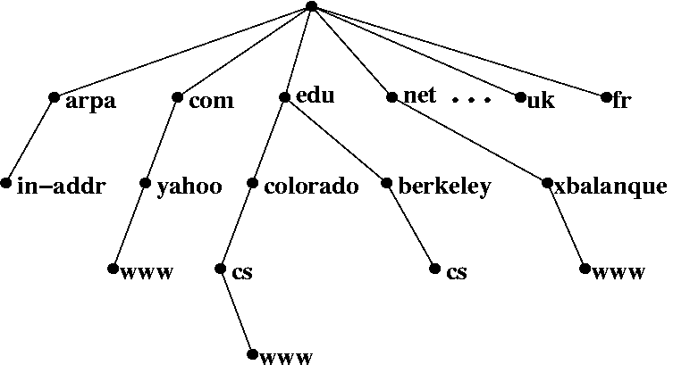
Notes:
So I assume everyone here is very familiar with how DNS hierarchy goes, from a subdomain all the way up the ROOT servers? Well think of this for a moment as a Tree – with the roots being the base of the tree (literally the roots), then branching into the various TLDs, domains, subdomains and so on.

Slide 7

Notes:
Well ICANN is only one tree in the forest that makes up the Internet. It is definitely by far the biggest such tree, but there are other DNS trees outside of it.
To access those other DNS trees you will either need to have a DNS Server that knows how to lookup your requests in multiple trees, or you can use a proxy to access them. In most cases an OS will not support these other trees out of the box, but its a very quick update to get access.
There are many other Alternative DNS Roots – or ADR for short, but almost all of them work in the same way as the classic ICANN setup – using standard DNS. The only differences stem from the root servers being outside ICANNS control. After that they have Domain Registrar etc. Lets have a look at some of them

Slide 8

Notes:
OpenNic has been running since 2000 as an ADR to ICANNs version of the internet. Their mission is to be a democratic, non-national alternative to ICANN. ICANN itself is seen to be closely tied to the US government in particular, and the people behind OpenNIC do not want any nation having complete control of the internet.

Slide 9
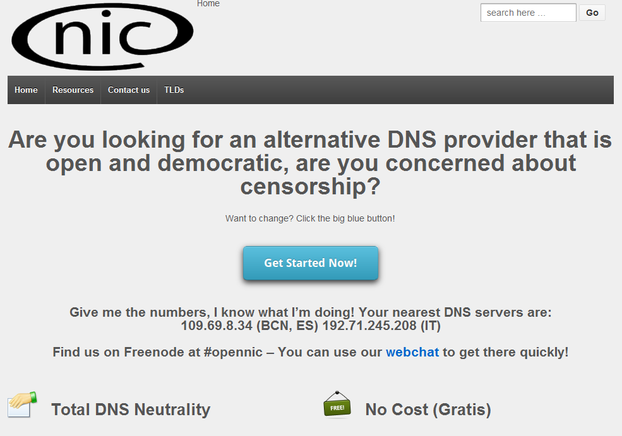
Notes:
As you can see from their site – they are pretty strong on pushing the open and democratic angles. You can also see how simple it is to use – just change your DNS to the one of the ones listed, and away you go.

Slide 10
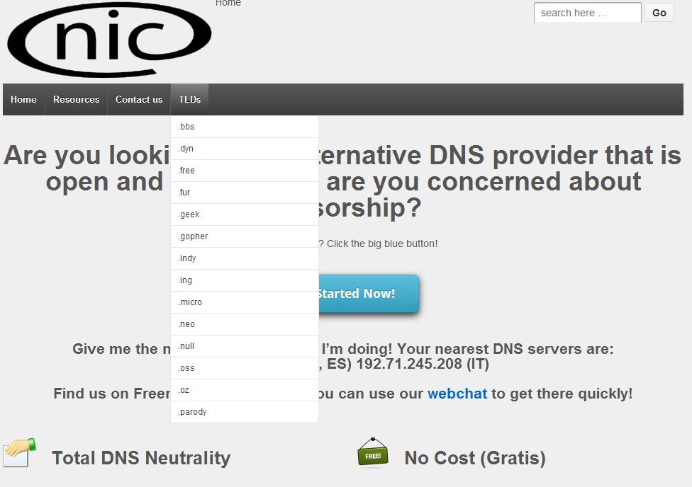
Notes:
They have a bunch of TLDs such as .pirate (for torrents etc), .bbs (for telnet style bbs) and .fur (you don’t want to know).
While each of these TLDs is designed with a certain type of site in mind, just like the recent ICANN .xxx which went live in 2011, you can of course register anything on them.

Slide 11

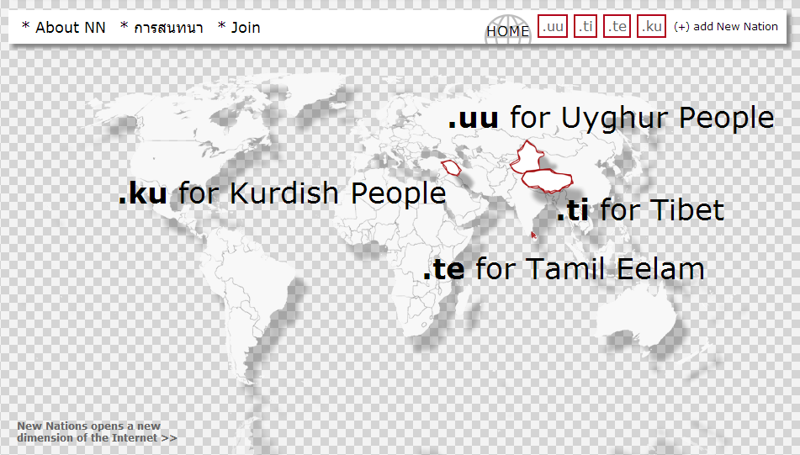
Notes:
Another ADR is New Nations. New Nations caters to various politically disputed countries that do not have their own official TLD from ICANN. So if you are looking to set up a site and your target market are Kurdish exiles, these are the guys you want to talk to.

Slide 12
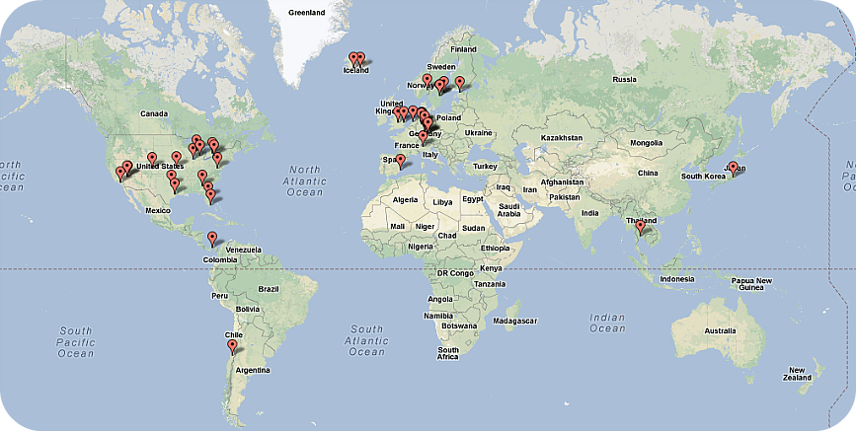
Notes:
And then you have a personal favourite of mine – Cesidian Root – which has root servers all across the globe
They have TLD such as .hack, .god and .science plus over 100 others. In technology terms they are no more interesting than any of the others, but what sets them apart is the person behind them.

Slide 13
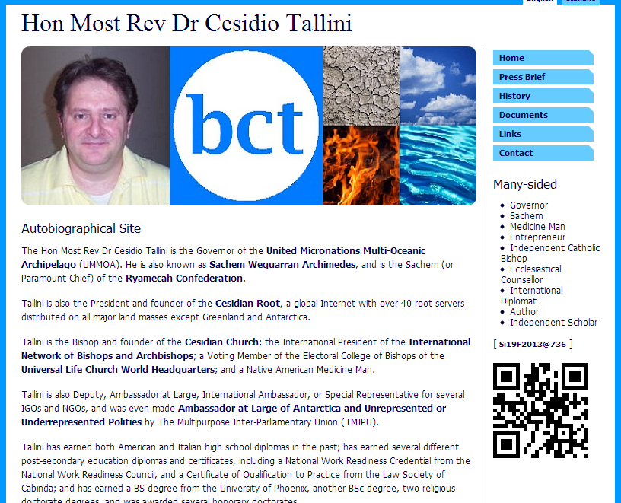
Notes:
Cesidian root is ran by a madman (well at least, slightly odd) who is the self appointed Honourable Most Reverent Dr Cesidio Tallini, the Governer of the United Micronations Multi-Oceanic Archipelago. He is also head of the church of Cesidian Church, has his own system for time and is generally a raving lunatic.
I highly recommend that everyone here goes and checks out his backstory – its one of the most entertaining things I’ve read in a long time.
Before getting onto .BIT, there is one other very interesting ADR – especially from a security perspective.

Slide 14
.42
Notes:
An experimental TLD called .42 was set up in 2011. The numbers comes from the book “The Hitchhikers Guide to the Galaxy”, where it is the answer to “Live , The Universe and Everything”.
But think about what this means for a minute, especially with a security / hacker hat on...

Slide 15
192.168.1.42
1.2.3.4
Notes:
If I register the domain 1.42, I can then setup a subdomain called 192.168 – and have an actual domain that LOOKS like an IP address, but which will resolve to a completely different IP address. Crafty isn’t it?
Now imagine an attacker creates a piece of malware that first changes your machines DNS server to support the .42 ADR, and then proceeds to communicate with a C&C server. If you are not paying full attention while checking your firewall and proxy logs you could very easily go off on a wild goose chase. It will also be interesting to see how each of the different browsers and so on actually deal with a domain like this.
Its worth noting that right now the .42 TLD does not let you register a numerical domain – but there is nothing stopping you from setting up your own numerical TLD e.g. .21 for all things Cork related.

Slide 16
.BIT
Notes:
So .BIT is also an ADR of course, but its an ADR with a difference – and that difference comes down to how you register a .BIT domain, and how a .BIT enabled DNS server knows which IP to resolve a domain name to.
All the other ADR use a standard DNS setup on the backend, but .BIT is different.

Slide 17
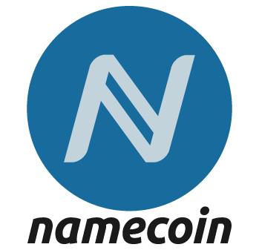
Notes:
In the backend .BIT is based on a crypto currency called Namecoin. This is a currency very similar to Bitcoin in setup. Just like in Bitcoin it is based on a P2P decentralized setup where users can mine coins. Unlike Bitcoin which is designed to buy goods, Namecoin is designed to securely register and transfer arbitary “names” without censorship. The main use cases are:
Registering domains with .BIT
Managing who owns a particular Nickname
Voting
Webs of trust etc.
I’m not going to go into details on how the mining of Namecoin works, because we may have a talk another month on Bitcoin – and its essentially the same process. But basically your computer is trying to solve cryptographic challenges and gets rewarded with coins when it succeeds.

Slide 18
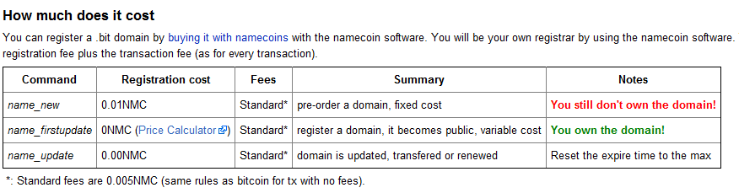
Notes:
In order to purchase a domain and get it setup you simply make a Namecoin transaction to yourself, and a small fee is subtracted. I’ll go into more details on how this works in a couple of slides time – but there are essentially 3 types of transactions.
The first of these is a name_new transaction, which costs you 0.01 NMC plus an additional 0.005 NMC which is a fee for any transaction. This does not mean you fully own the domain at this stage – that does not happen until you make a name_firstupdate transaction later.
The reason behind this is that because the whole .BIT system is decentralised, two people could potentially register the same domain at the same time – so how do you resolve that. Well what happens is you generate a hash of the domain name you want as part of the name_new transaction. You then wait for a certain number of transactions to pass, which normally takes a few hours. This gives a chance for the whole system to sync up. At this stage if you where the first person to purchase the domain you are entitled to carry out a first_update transaction and assign an IP address to it.
The other sort of transaction is a name_update which simply lets you point the domain to a new IP address.
When our team was looking at .BIT domains, we quickly realised that .BIT has 4 main advantages for attackers...

Slide 19

Notes:
Firstly they are really, really cheap – lets look at how cheap exactly

Slide 20
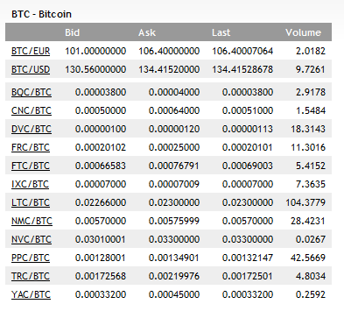
Notes:
There are no real exchanges that let you purchase Namecoins directly from another currency – most people purchase them with BITcoins.
Here is a snapshot of the Bitcoin exchange rates taken on one day recently. Lets take the BTC / USD exchange rate for an example...

Slide 21
134 USD / BTC x
0.00576 BTC / NMC x
0.015 NMC / domain =
1.1 cent per domain !!!
Notes:
So at 134 USD for 1 BTC, and you need 0.00576 BTC per NMC, and finally it will cost you 0.015 NMC for a domain.
Leads to a grand total of 1.1c per domain, and even less as Bitcoin prices decrease. You can also register a domain easily via an API which is useful for things like a DGA botnet.

Slide 22

Notes:
Secondly, Sinkholing these sites at a domain level is not going to work. For starters they are outside of the control of ICANN and the various national TLD. But more importantly because domain registration and updating is based on Crypto Namecoin transactions – the only way for a 3rd party to redirect the domain is to gain access to the Namecoin wallet of the attacker.

Slide 23
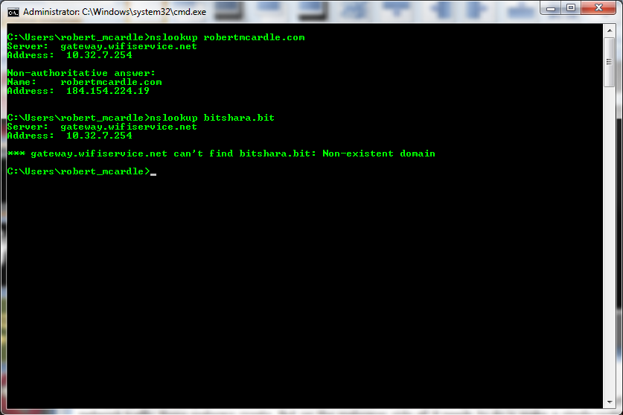
Notes:
Third, they are a real pain for automated sandboxes and AV crawlers. If your sandbox does not support .BIT (and other ADR) you will be completely blind to the network traffic these malware create. But on the malwares side all it needs to do is make a single registry change to use a different DNS server – and its good to go.

Slide 24

Notes:
And Lastly, They are essentially Anonymous (not the Guy Fawkes wearing version) – there is no Whois system as such for .BIT. Even fake Whois details will be useful to an investigator – but in .BIT the best you can get is the Namecoin wallet ID that paid to update a sites details
So what we next decided to do next was to investigate more the .BIT C&C we could see connections for, and see did all of these assumed advantages actually hold up.

Slide 25
Notes:
Firstly there is no doubt these domains remain really cheap, and really easy to setup.
The cost for a domain in Namecoin is standardised, but Namecoin itself is tied to Bitcoin in terms of its value – so it’s value does fluctuate over time. Even taking that into account the price of a .BIT domain has varied from a couple of cents up to a dollar over the last couple of months.

Slide 26
Notes:
As for sinkholing at the domain level – this also holds up. Unless you can gain access to an attackers Namecoin wallet – you can not make changes to the domain.
Of course the inverse is true – if you DO gain access to an attackers wallet (e.g. By Hacking them), then you can take over ALL of their domains.

Slide 27
Notes:
For Automated backend systems and crawlers to handle ADRs in general there are some simple fixes that you can think about implementing. On the backend we can ensure that all our DNS servers also support all of the know ADRs. Alternatively you can update a security products architecture to push more analysis out to the local customer machines – as these will have the correct settings once compromised.

Slide 28
Notes:
And Lastly, and most interestingly – how anonymous are these domains.
Well lets look at a Namecoin transaction...

Slide 29
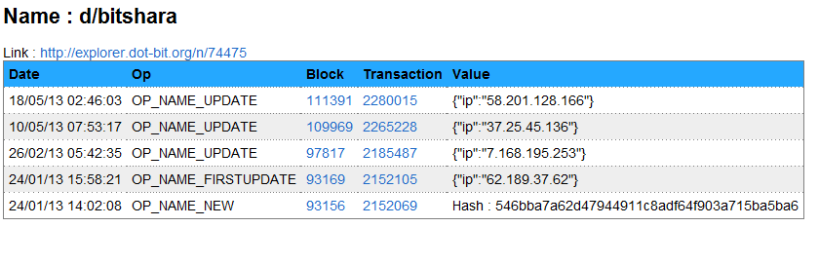
Notes:
So here are all the transaction related to the bitshara.bit domain
All of these transactions are fully public by design as the entire transaction chain or block chain needs to able to be pulled down by any .BIT DNS server in order to resolve domains, or by any body buying a domain with namecoin.

Slide 30
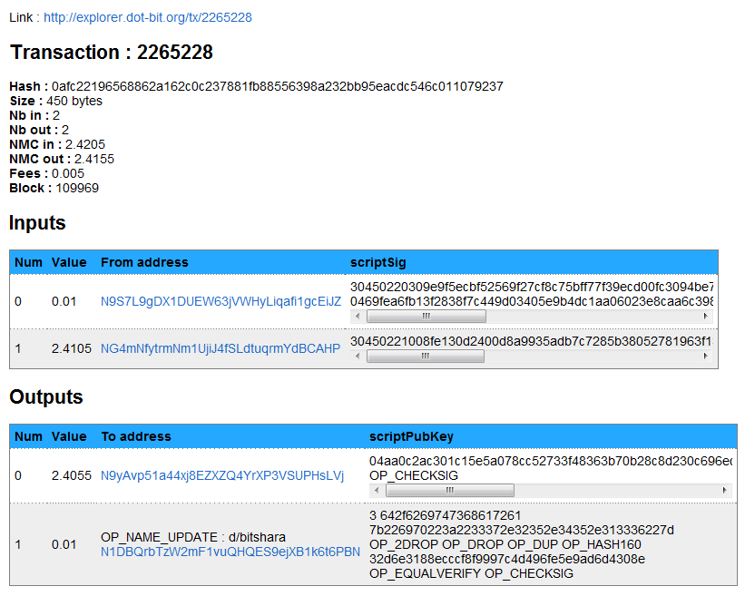
Notes:
Each Transaction has 1 or more input wallet IDs (where the money is coming from), and one or more output wallet IDs (where the money is going to). Also all Namecoin transactions are subject to a very small 0.005 NMC transaction fee.
In the case of registering a domain or a first update there is a small additional fee, but each time that you wish to change what IP a domain points to (including the first update) there is no additional fees. For example this transaction is a name_update transaction, to update the IP of Bitshara.bit – and it has a total of 0.005 NMC in fees.
An attacker can of course use the same wallet for both input and output – but that is not best practice as you can then link all transactions to one person. So in most cases they will use a lot of different wallet ids, and some local client to keep track of them all.
But these series of input and output transactions can be joined together in a chain. Lets start by looking at one of the wallet codes used in the Inputs.

Slide 31
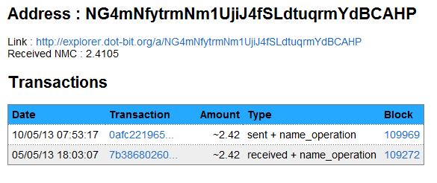
Notes:
This same wallet code was used in two transactions. The first was as the input to the one we just looked at (indicated as “sent”), but was the output of another transaction (indicated as “received”). Lets have a look at that transaction...

Slide 32
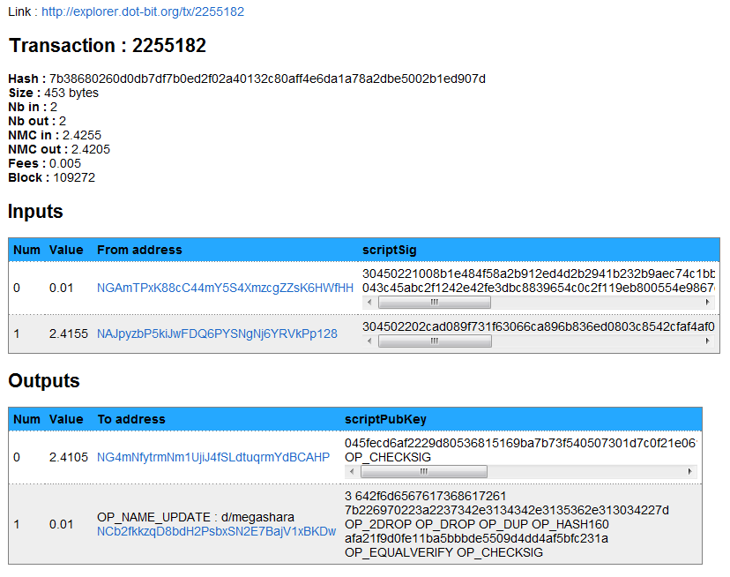
Notes:
Here you can see the same wallet code being used as the first output of this transaction, but interestingly – this transaction is for another .bit domain – MegaShara.bit, which is also associated with malware.

Slide 33
Input
Output
Later Transaction
Previous Transaction
Notes:
So in this way we can look through all the transactions to see which transaction resulted in money ending up in the Input wallet...

Slide 34
Previous Transaction
Input
Output
Later Transaction
Notes:
... and also what later transactions made use of the Output wallet...

Slide 35
Previous Transaction
Input
Output
Later Transaction
Notes:
This is a BIG FLAW in Namecoin. For Bitcoin transactions this can be a real mess – even though the transactions are public, you do not know who owns the input and output wallets.
But in Namecoin you are almost always transferring Namecoins from yourself to yourself for the purpose of updating a domain, so we can easily link all your transactions together. A smart attacker would occasionally send Namecoins to others, or even donate them to charity just to mess up the chain.
Using this flaw we were able to take the Bitshara.bit domain...

Slide 36
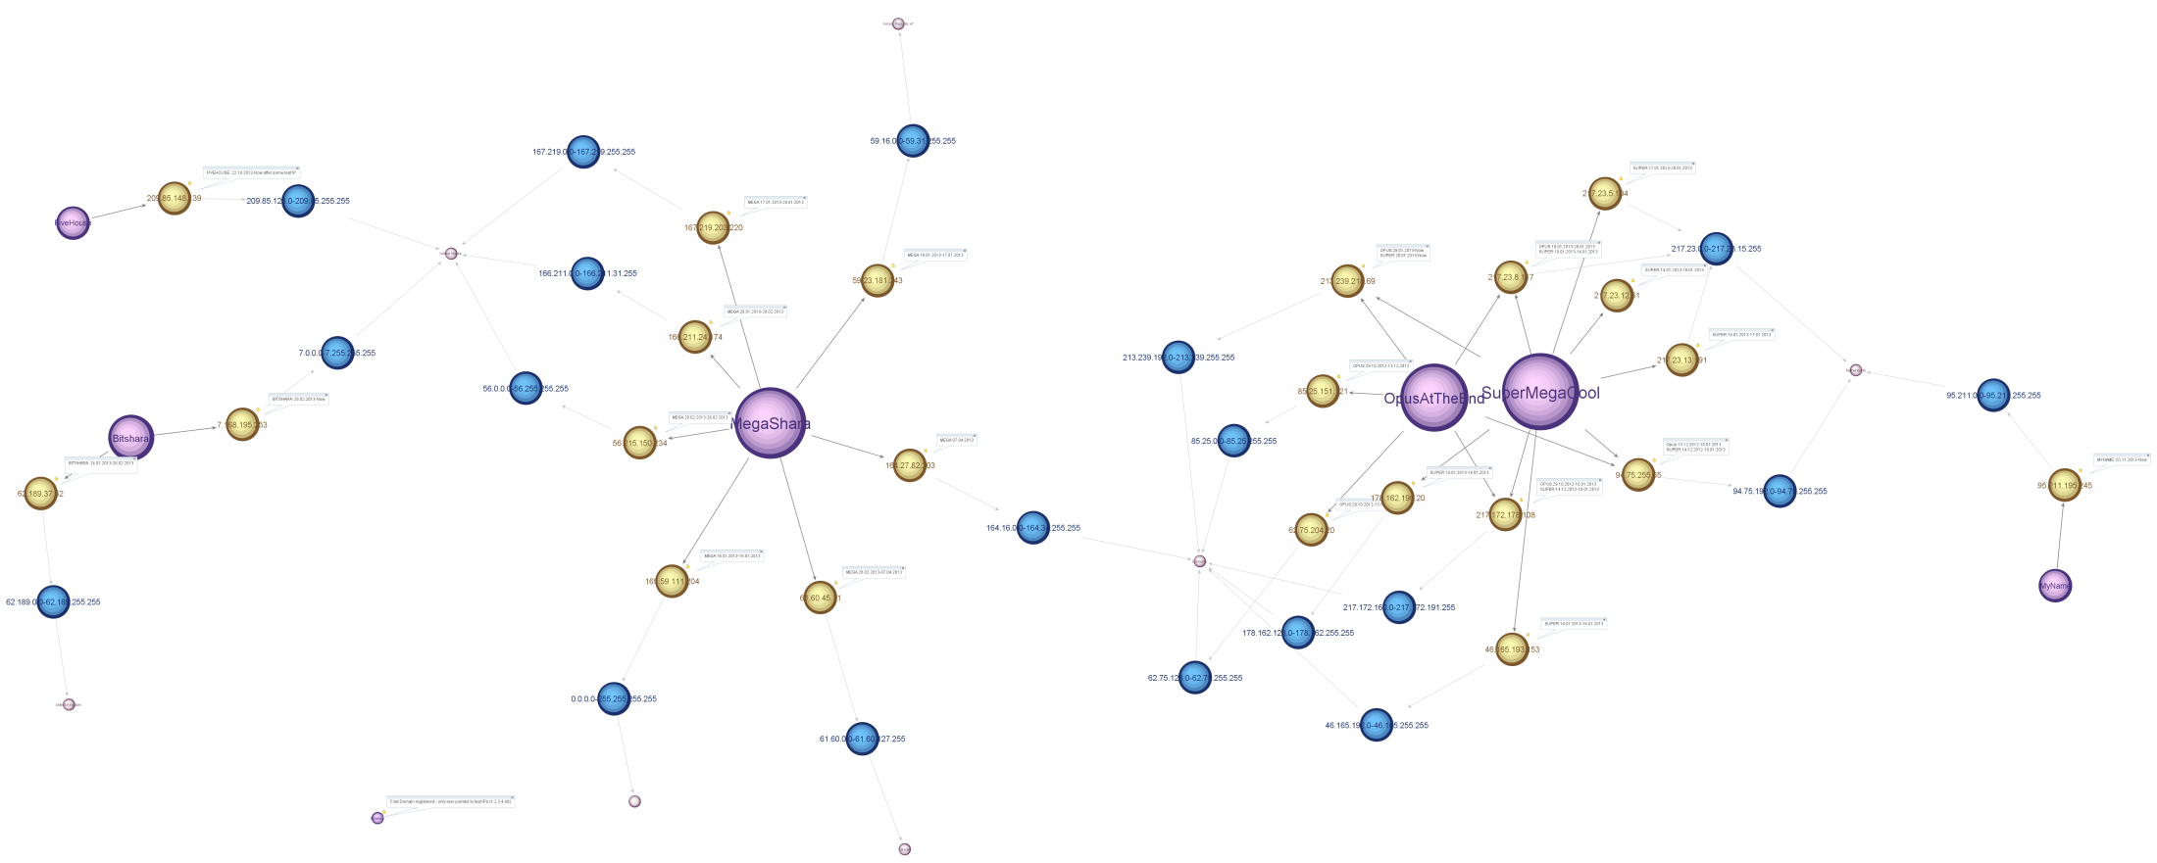
Notes:
And link it to EVERY SINGLE TRANSACTION the attacker carried out since purchasing / mining the coins in the first place. Every domain registered. Every IP update. Everything.
So if you find a single .BIT domain you can see every domain an attacker owns, and its cryptographically verified. That's even better than Whois matching. We can also see at exactly what date they moved servers
Of course – none of that chain actually reveals the attackers identity, just the connection between the domains. But this is where attacker lazyness can be used against them. If we want to tie this back to a real attacker we can look for Non .BIT domains hosted on the same IPs at the same time, with the same path as the .BIT malware and which where also updated around the same time. This is because its likely that if an attacker has to move from one server to another – he will need to move ALL of his domains
Also all of the .BIT malware from the family we have seen have fallback hardcoded domains in regular ICANN space – which is a massive FAIL. Rule 1 of Opsec is never contaminate your false identity with your real one.
So those failings mean that while on paper on .BIT initially looked like a criminals dream come through, it does not hold up so well in practice. In the meantime I hope tonight opened your mind up to an entire part of the internet you probably never accessed before, so have fun surfing around the ADRs – but definitely keep clear of .FUR ☺

Slide 37

Notes:
Everyone – thanks for coming, and I hope you enjoyed the first part of Cork | Sec (the rest being some beers). Any questions?

Slide 38


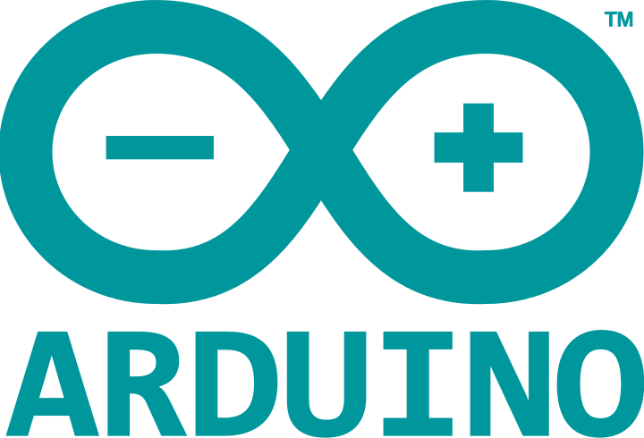

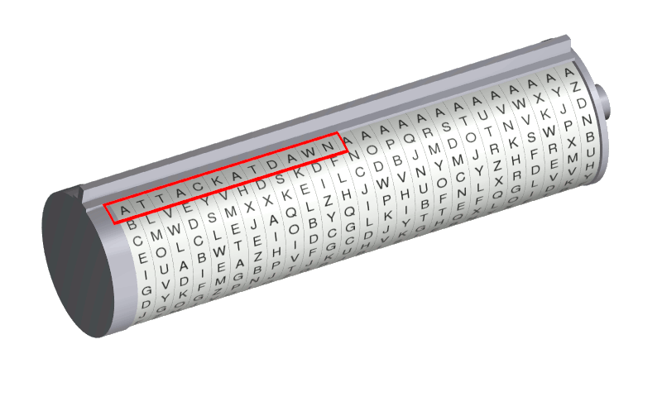
Notes:
Before we get to the socialising part – here are some topics people have already said they would love to see someone present on. So if you know anything about any of these it would be great to see you up here next month instead of Marcus or myself ☺
Bitcoin
TOR
Arduino
Crypto
3D Printing
And of course there are pile of security tools like Nmap, Metasploit, SET, Aircrack and lots more – so please do volunteer!

Slide 39

Cork | Sec #2 (AKA DC021353) 20:15-??? MORE Socialising ☺
Notes:
So for the rest of the evening – unless anyone else has anything they want to say, feel free to mingle and socialise and grab a beer – or just head on. Try and talk to at least one other person that you had not met before.
In order to be able to run this on a monthly basis we need speakers as well as drinkers – so if you have any topic that you are interested in chatting about, please don’t be afraid – and do let me know in the next two weeks. The talks do not need to be polished at all – this is a great setting to try out some ideas you are working on . And even if you don’t have a full 40 mins – no issue either we can put a few talks together.
Oh and don’t forget to check out CorkSec.RobertMcArdle.com

